Slide 1

Da Nang, 26-5-2024
Notes:
Good morning, Hello Council and everyone in the room at Capstone Project Defense today, I'm Thao, representing my team to present our project.

Slide 2


Team 3
Nguyen Tuan Kiet
Nguyen Van Khai
Tran Van Duc
Dinh Thi Kim Diem
2/20

Slide 3
Table of content
1. Problem
2. Goals of The Project
3. System Context
4. Database Design
5. Demo

Slide 4
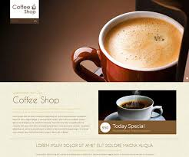
1. Problem
“In the era of technology and world society developing industry 4.0 and digital transformation, the higher people's demand for coffee, we will offer a solution to order coffee online without having to go to the shop..”

Slide 5
2. Goals of The Project
The goal of the project is to create a system that allows users to automatically order coffee at home:
View ordering information
Buy coffee
See types of coffee
Order coffee

Slide 6
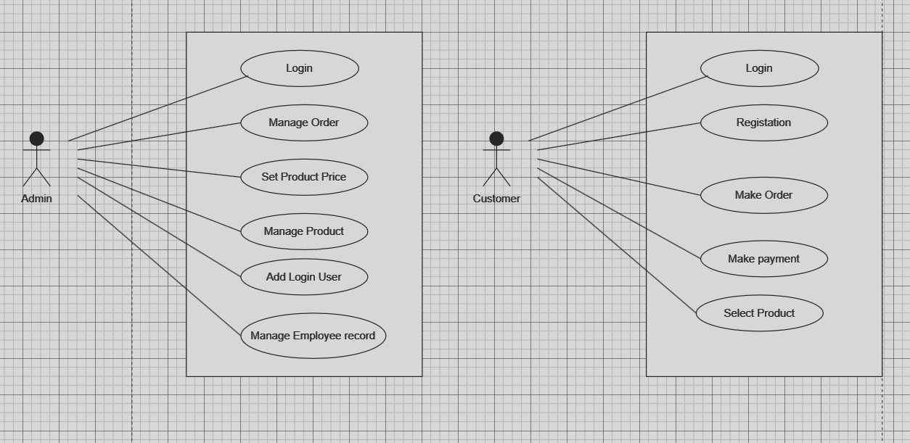
3. System Context
Main features of the system:

Slide 7
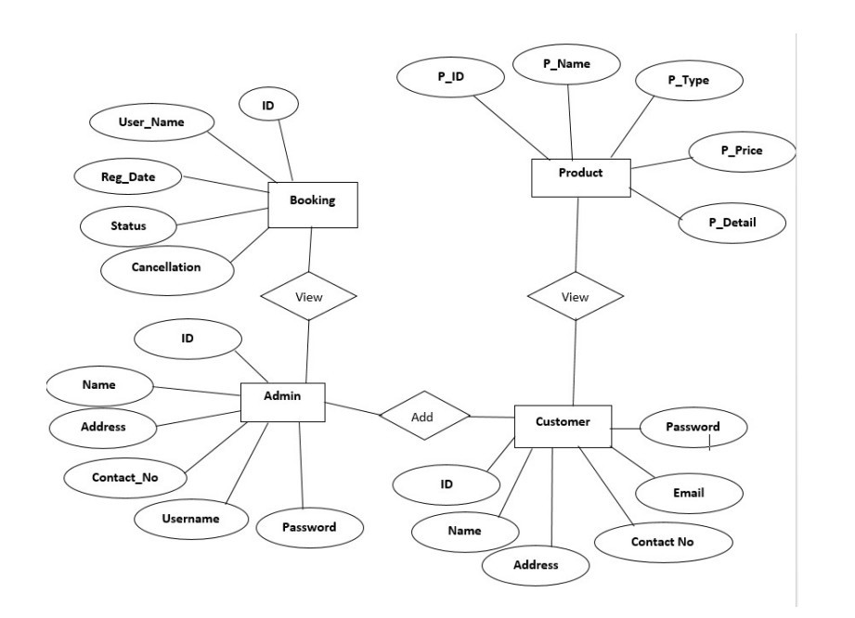
4. Database Design

Slide 8
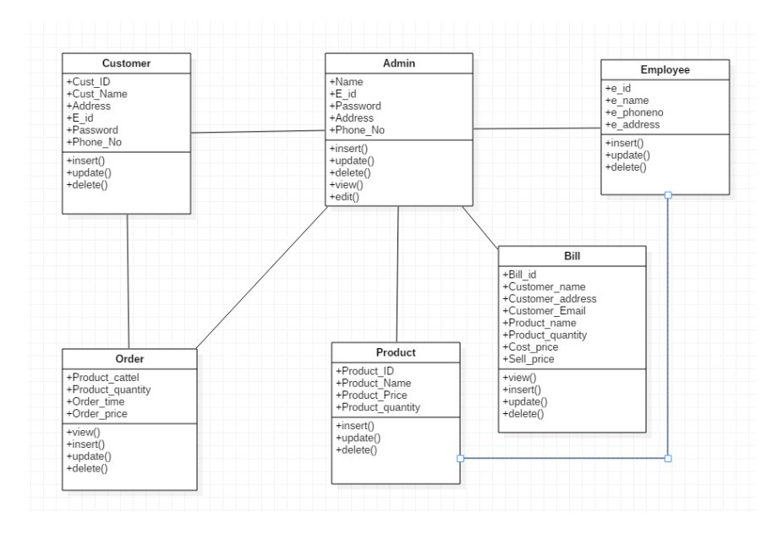
Database Design

Slide 9

5. Demo

Slide 10
THANKS YOU FOR LISTENING MY PRESENTATION!

